Slide 1
Overview of Intervention Mapping

Slide 2
Overview
The development of Intervention Mapping was stimulated by questions that could not be answered from available health education and health promotion resources
?

Slide 3
How and When to Use... ?
Intervention Mapping was developed to address question about how and when to use...
Theory
Empirical findings from the literature
Data collected from a population
...to create an effective behavior or systems change intervention

Slide 4
How to Take an Ecological Approach to Planning
Supranation
Society
Community
Organization
Interpersonal
Individual

Slide 5
How to Take an Ecological Approach to Planning
How to address changing the behavior of people in the environment (i.e. people who are not at risk for the health problem, but are important to changing conditions that affect those at risk)?
How to address the complexity of multi-causation of problems and multi-level intervention points?

Slide 6
What is Intervention Mapping?
A systematic approach to program development, implementation & evaluation
It provides a framework for decision-making at each step
Theory
Empirical evidence
Community input (important for cultural relevance)
Uses an ecological approach

Slide 7
Participation in Health Promotion Planning
Equitable community participation
Ensures program focus reflects community concerns
Brings greater breadth of skills, knowledge & expertise
Improves external validity

Slide 8
Intervention Mapping Steps
Logic model of the problem
Program outcomes and objectives (logic model of change)
Program design
Program production
Program implementation plan
Evaluation plan

Slide 9
Step 1: Needs Assessment
Establish and work with a planning group
Conduct a needs assessment to create a logic model of the problem
Describe the intervention context, including the population, setting, and community
State program goals

Slide 10
Logic Model of the Problem
INSERT Figure 1.2 HERE
Figure 1.2

Slide 11
Step 2: Program Outcomes & Objectives - Logic Model of Change
State expected outcomes for behavior and environment
Specify performance objectives for behavioral and environmental outcomes
Select determinants for behavioral and environmental outcomes
Construct matrices of change objectives
Create a logic model of change

Slide 12
Create Matrices of Change Objectives
 | Determinant 1 | Determinant 2
Performance Objective 1 | Change Objective | Change Objective
Performance Objective 2 | Change Objective | Change Objective

Slide 13
Examples of Cells from a Simulated Matrix: Consistently and Correctly Using Condoms During Sexual Intercourse Determinants
Performance Objectives | Knowledge | Perceived Susceptibility | Self-Efficacy
1. Buy a condom | Identify places List condom types | State personal risk for HIV, STI, & pregnancy if have sex without a condom | Feel confident about buying a condom
2. Carry condoms | List different ways to carry condoms | Perceive that not carrying a condom increases risk | Feel confident about carrying condoms
3. Use condom correctly | List 10 steps for correct condom use | State risk of HIV, STI, & pregnancy increases if condom is not used correctly | Feel confident about using condoms correctly

Slide 14
Logic Model of Change
INSERT Figure 1.3 HERE
Figure 1.3

Slide 15
Step 3: Program Design
Generate program themes, components, scope, and sequence
Choose theory- and evidence-based change methods
Select or design practical applications to deliver change methods

Slide 16
Step 4: Program Production
Refine program structure and organization
Prepare plans for program materials
Draft messages, materials, and protocols
Pretest program materials & protocols

Slide 17
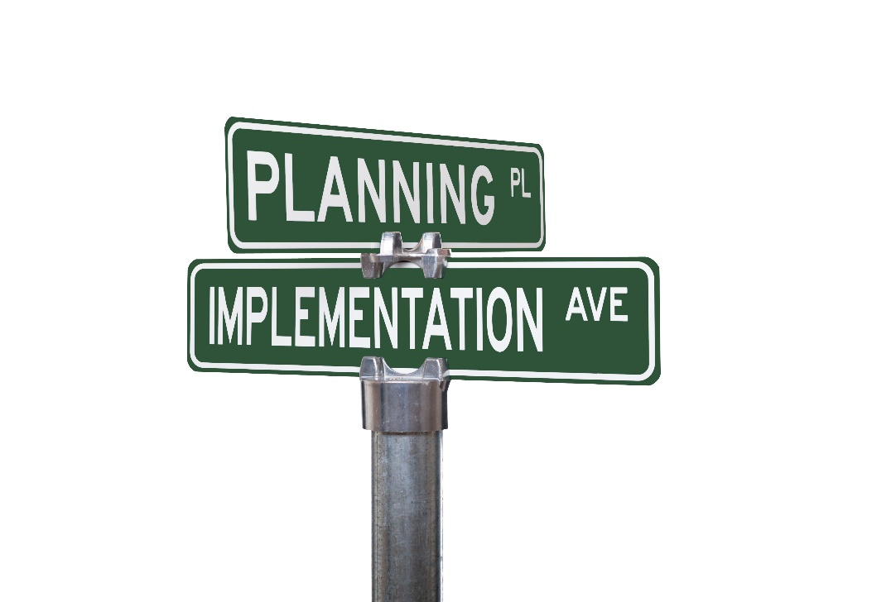
Step 5: Program Implementation Plan
Identify potential uses (adopters, implementer, and maintainers)
State outcomes and performance objectives for program use
Construct matrices of change objective for program use.
Design implementation interventions for

Slide 18
Step 6: Evaluation Plan
Write effect and process evaluation questions
Develop indicators and measures for assessment
Specify the evaluation design
Complete the evaluation plan

Slide 19
Intervention Logic Model
INSERT Figure 9.1 HERE
Figure 9.1

Slide 20
Core Processes
Pose questions
Brainstorm potential answers to the questions
Review findings from the empirical literature for theory- and evidence-based answers to questions
Review theories for additional constructs
Assess and address need for new data
Formulate a working list of answers

Slide 21
Important Repeating Concepts
Formulation of matrices is a foundation for intervention planning
Planning is an iterative process
Use of logic models
Need to create culturally relevant programs
Program evaluation

Slide 22
Summary
Intervention Mapping provides a systematic framework for effective decision making at each step of intervention planning, implementation, and evaluation
Intervention Mapping has been used to develop programs worldwide

